Slide 1
US Fires (1992-2015)
Bassam Aziz, Noor Habib, Lei Sabarre, Sam Struthers

Slide 2
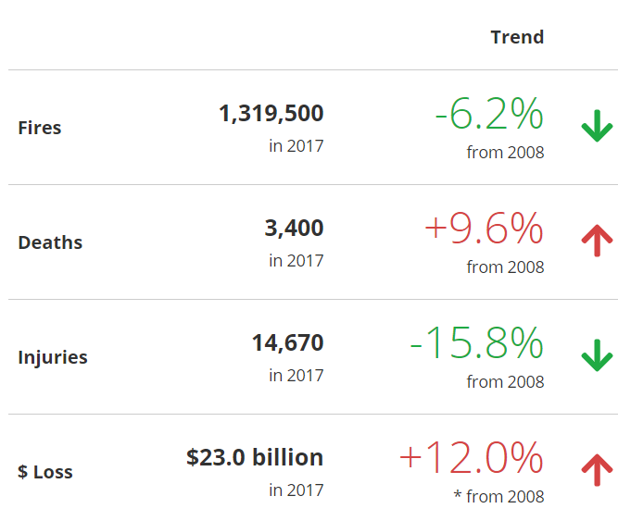
Motivation/Summary
We live in a frequent fire state >
Stats from FEMA 2008-2017
Is there a correlation between…?
Fire cause and size/frequency of fires
State and cause/size/frequency
Trends in size/frequency YOY
Increase in average size of fires YOY
Lightning is biggest contributor to fire size
West Coast has the most fires (over 15K acres)
2015 is the most recent year of data - limitor
Notes:
15K acres - limitor for relatively insignificant fires

Slide 3
Questions & Data
Is count or size of fires more significant?
Broad US data…?
Is there a YOY trend in count of fires or size of fires?
Is there a consistent top cause of fire?
Are there causes that result primarily in the largest fires?
Are fires avoidable for the most part?
Are there correlations between cause of fire and fire size?
State data…?
Are there any states that have trends YOY?
Are there correlations between weather and fire size by state?

Slide 4
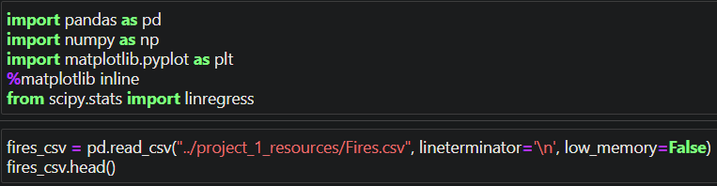
Data Cleanup & Exploration
CSV file was found containing 23 years of fire data for the US
Short, Karen C. 2017. Spatial wildfire occurrence data for the United States, 1992-2015 [FPA_FOD_20170508]. 4th Edition. Fort Collins, CO: Forest Service Research Data Archive. https://doi.org/10.2737/RDS-2013-0009.4
Unusable rows – drop N/A
39 data points => 9 data points
JN helped navigate almost 1 million lines of data

Slide 5
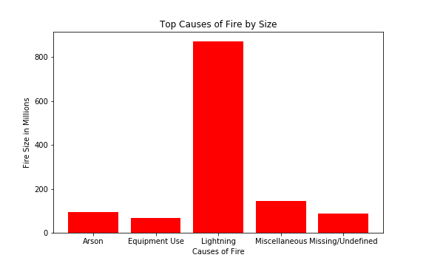
Data Analysis

Slide 6
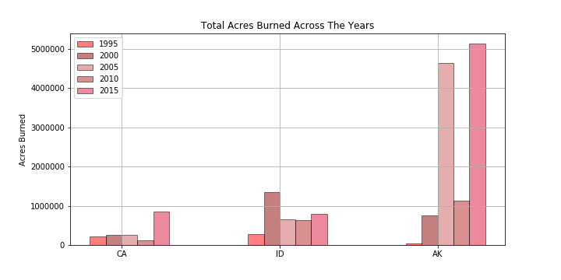
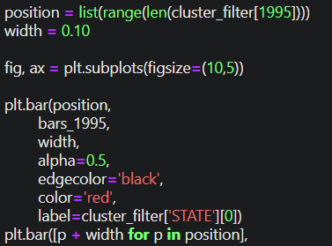
Data Analysis

Slide 7
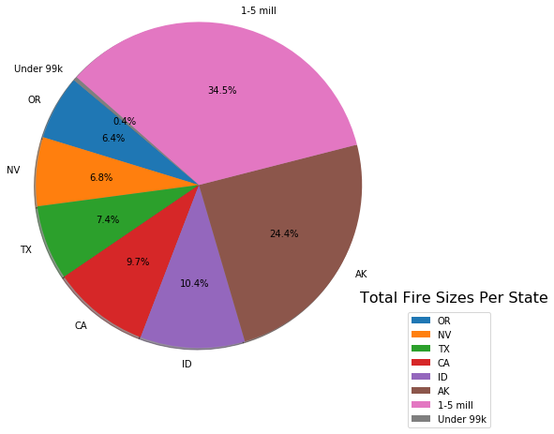
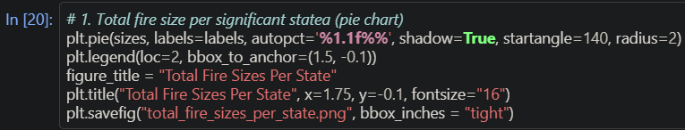
Data Analysis

Slide 8
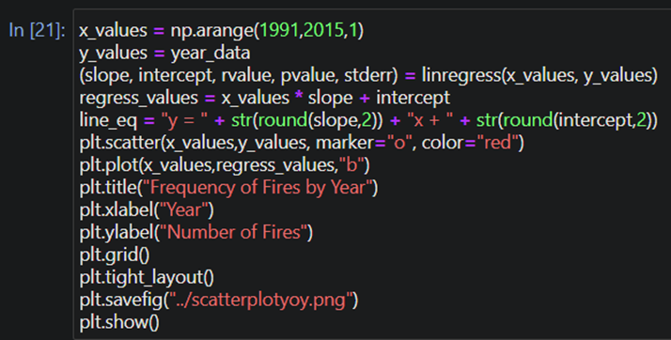
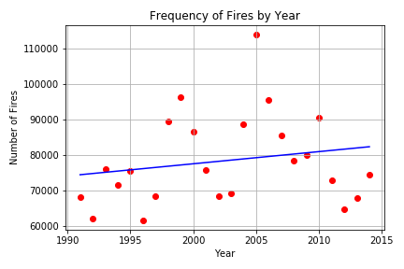
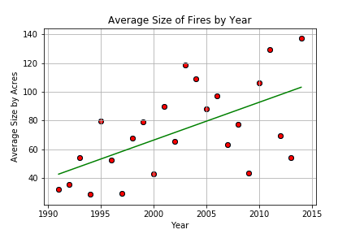
Data Analysis

Slide 9
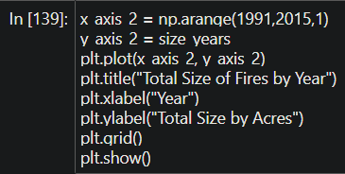
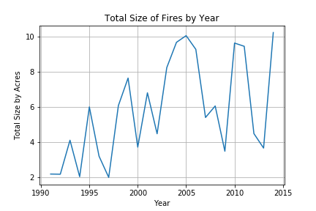
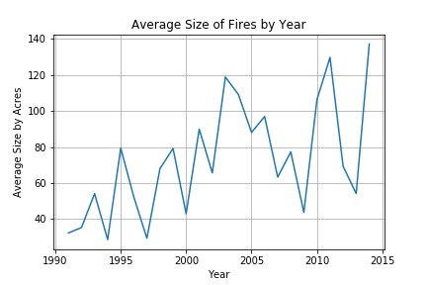
Data Analysis

Slide 10
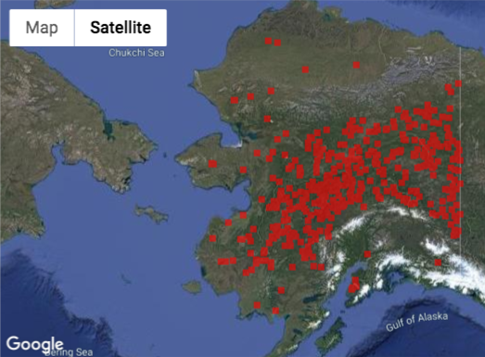
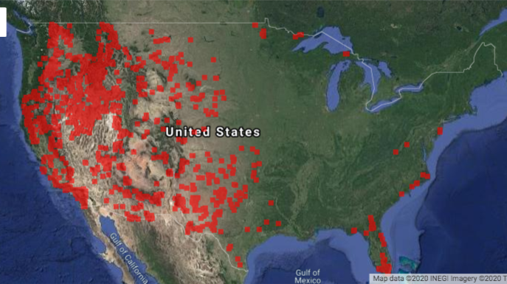
Data Analysis

Slide 11
Discussion
States with low stats decrease the trends YOY/State to State
There are correlations between types of fire and fire size
There is an obvious concentration of fires on the West Coast from California up to Alaska

Slide 12
Post Mortem
The data needed special encoding
Filtering thru the full file and slicing and dicing states for more concise comparisons were tedious

Slide 13
Questions

